Slide 1

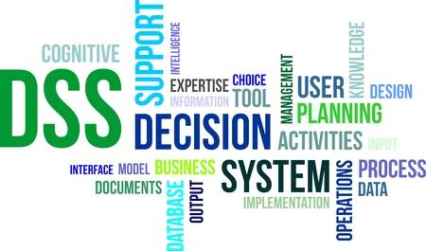
Decision Support System
CHAPTER 2
Business Intelligence: Carlo Vercellis

Slide 2
Decision Support System
Interactive computer based application
Combines data and mathematical models
Helps decision makers solve complex problems
Basic component of BI architecture

Slide 3
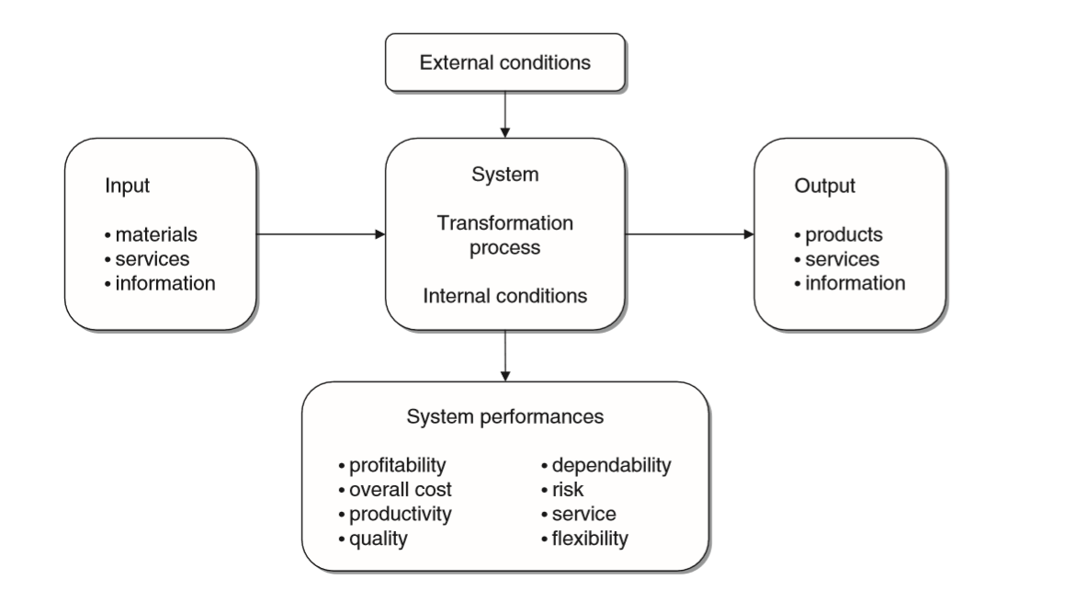
Abstract representation of a system
Every system is characterized by boundaries that separate its internal components from the external environment

Slide 4
Performance of a system: Evaluation metrics
Effectiveness
Efficiency

Slide 5
Representation of decision making process
Rationality and problem solving
The decision making process
Types of decisions
Approaches' to decision making process

Slide 6
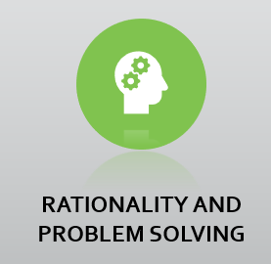
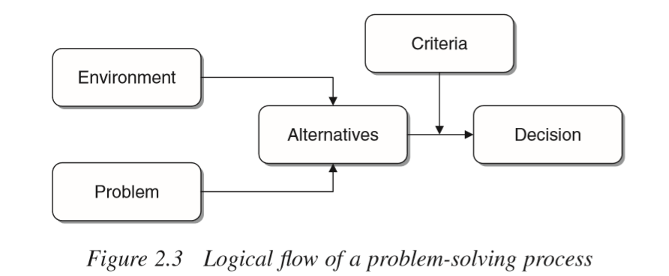
Factors influencing rational choice
Economic
Technical
Legal
Ethical
Procedural
Political

Slide 7
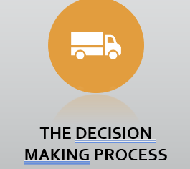
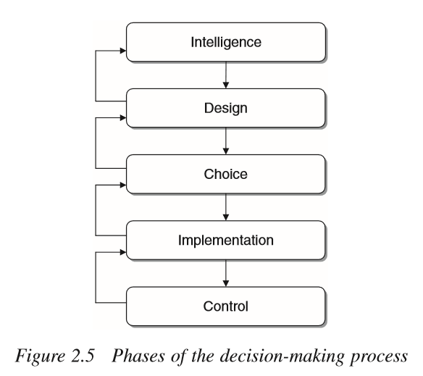

Slide 8
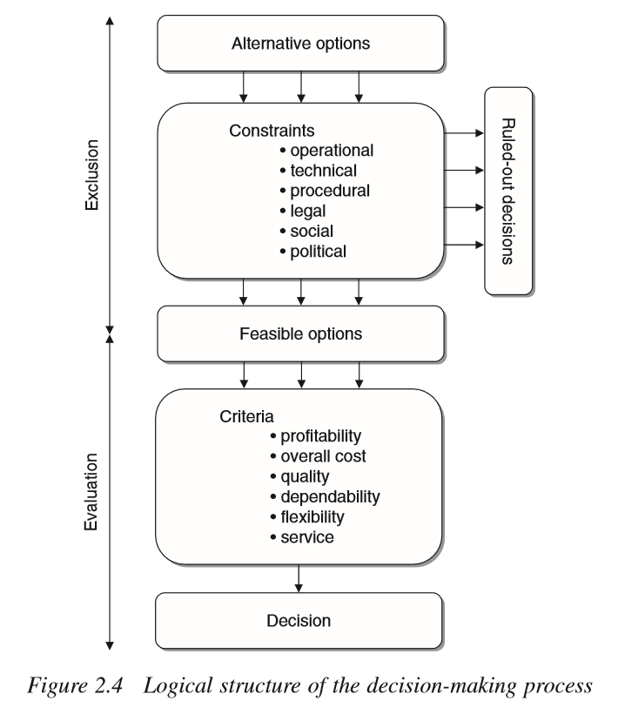

Slide 9
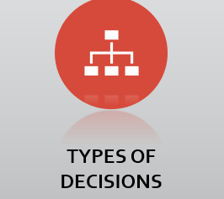
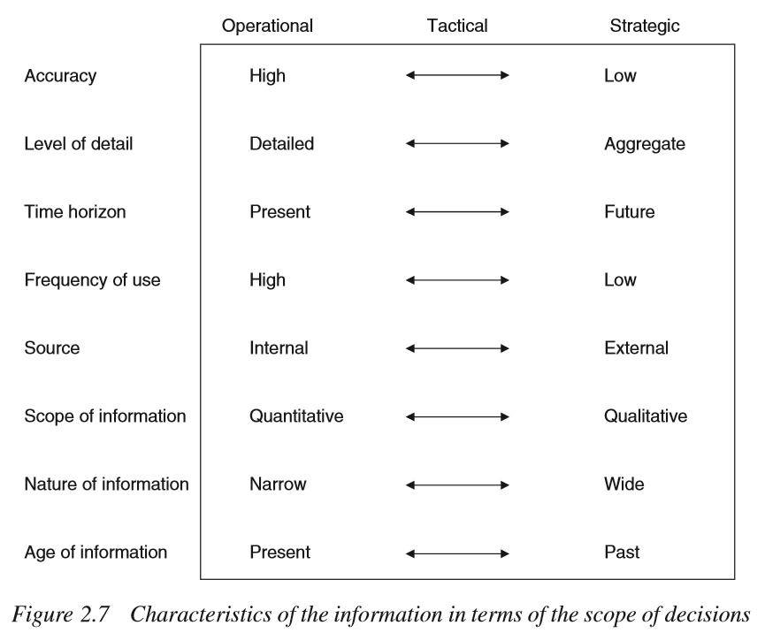
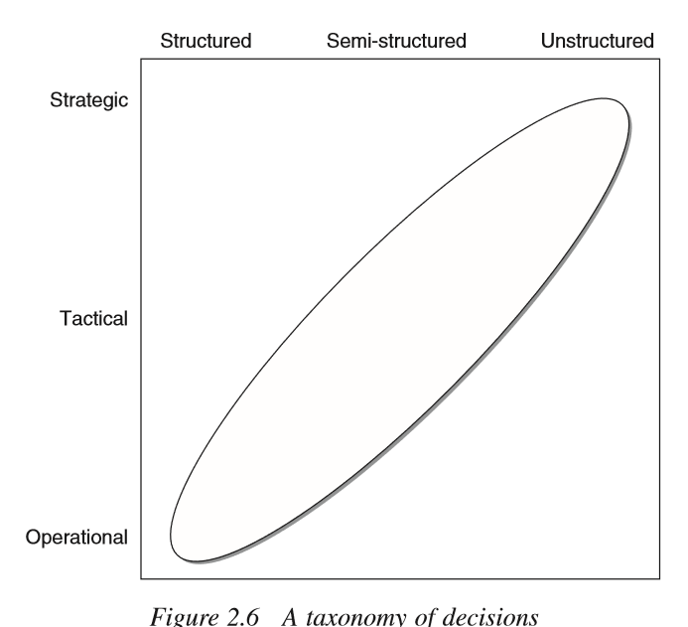

Slide 10
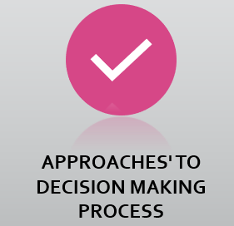
RATIONAL
  Absolute Rationality
  Bounded Rationality
POLITICAL - ORGANIZATIONAL

Slide 11
Evolution of Information systems
Data processing
Management information systems (MIS)
Decision support System (DSS)
Executive/Strategic information systems
Client-Server Computing
Data warehouses/Data marts
Business Intelligence

Slide 12
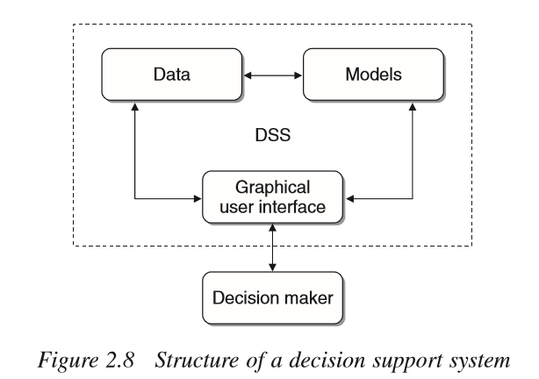
Definition of DSS
Features
  Effectiveness
  Mathematical Models
  Integration in the decision making process
  Organizational role
  Flexibility

Slide 13
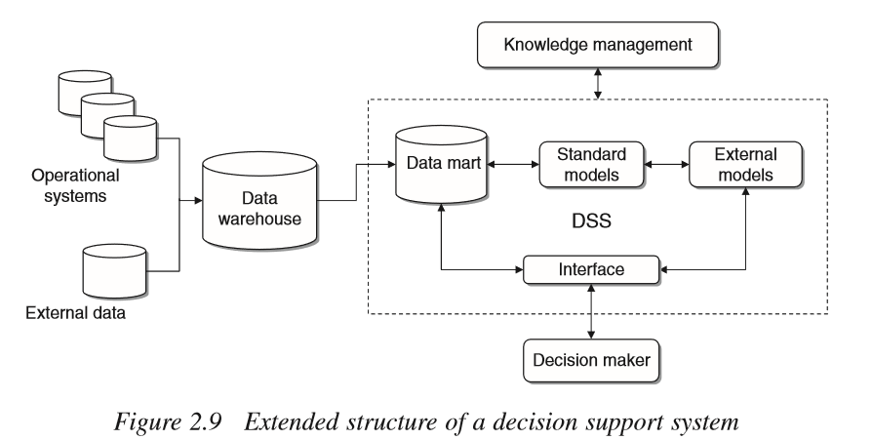

Slide 14
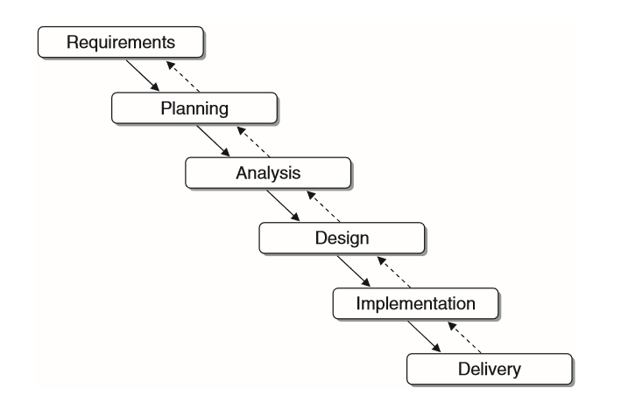
Phases in the development of DSS

